Slide 1


Group Members:
Syed Yousaf Raza (70139122
Saad Naveed (70137375)
Abdur Rahim (70135511)
Contract.AI
Understand before you sign
Supervisor:
Sir Hafiz Ali Younas
Session:Spring-2023-27

Slide 2

Introduction
Legal documents in Pakistan govern everyday life — from rental agreements to employment contracts and business partnerships.
However, most citizens face critical barriers:
  Formal Urdu script — difficult to read for millions
  No affordable legal consultation available
  Existing tools offer translation — not legal interpretation
These barriers leave tenants, freelancers, and small business owners signing contracts they do not understand — exposing them to hidden penalties, financial loss, and exploitation.

Slide 3
Problem Statement
Ordinary Pakistani citizens cannot comprehend Urdu legal documents because existing solutions:
  Provide translation only — no legal risk interpretation
  Offer no Roman Urdu output for digital accessibility
  Are English-only with enterprise-level pricing
  Have no understanding of Pakistani legal context
As a result, citizens unknowingly sign contracts containing hidden penalties, unfair termination clauses, and financial liabilities — with no affordable help available.

Slide 4
Objectives
Significance
  Develop a web-based platform for uploading Urdu legal documents
  Implement OCR pipeline to extract Urdu text from scanned documents
  Build NLP-based risk detection for penalty, financial, termination, and jurisdiction clauses
  Develop Urdu to Roman Urdu transliteration module
  Generate plain-language Roman Urdu explanations for each detected risk
  Design an simple frontend for non-technical users
  Protects vulnerable citizens from exploitative contracts
  Makes legal comprehension accessible without a lawyer
  First localised legal AI tool built for Pakistan
  Delivers output in Roman Urdu — the format Pakistanis use daily
  Free to use — no enterprise pricing or registration required

Slide 5
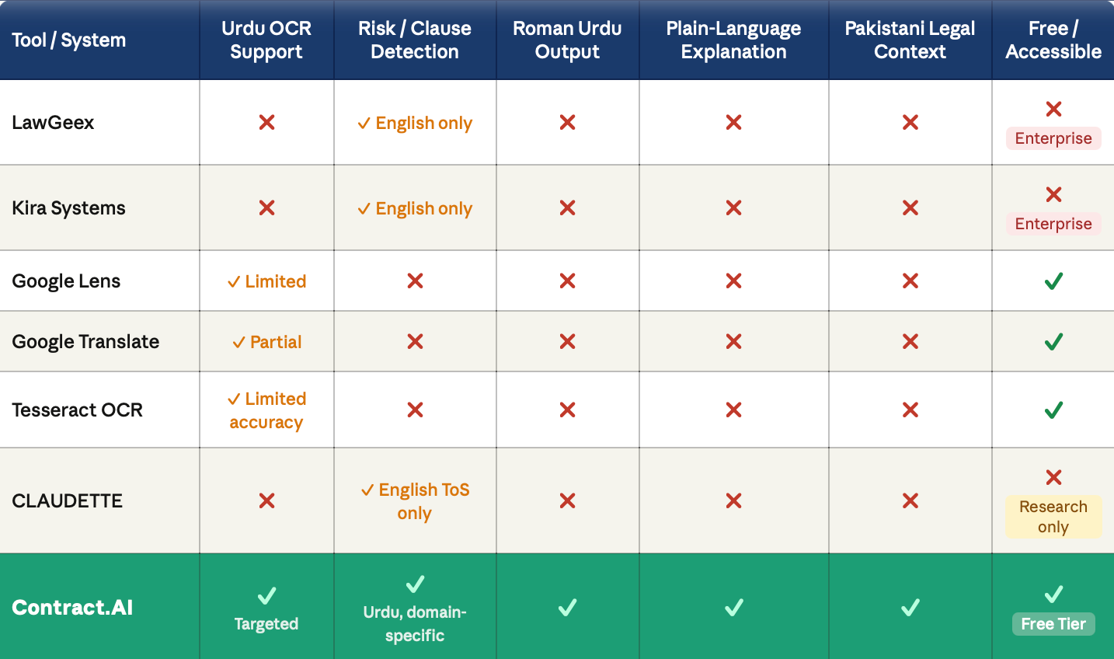
Comparative Analysis

Slide 6
Research Gap
No localised legal AI for Pakistan
No Roman Urdu output in any legal tool
OCR without legal interpretation
No Pakistani legal risk classification model
No plain-language explanation
All legal AI tools financially inaccessible

Slide 7

Proposed Solution – Contract.AI
A web-based AI tool that extracts, analyses, and explains Urdu legal documents in plain Roman Urdu.
Workflow:
  Upload Urdu legal document (PDF, image, or scan)
  OCR extracts Urdu text
  NLP detects risky clauses and assigns risk levels
  Results displayed in Roman Urdu with plain-language explanations
Outputs:
  Colour-coded Urdu text with risk highlights
  Full Roman Urdu transliteration of the document
  Risk report with plain-language explanation

Slide 8
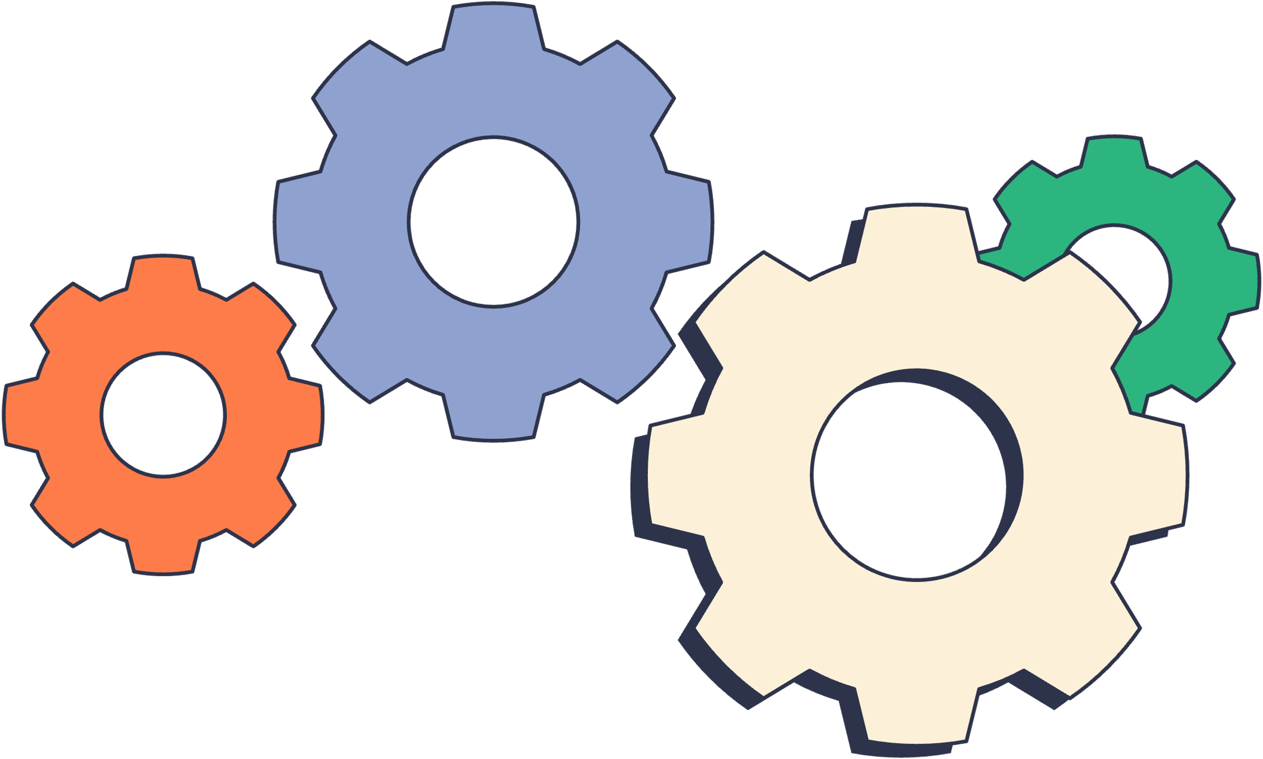
Functional Requirements
Document Upload
Analysis Pipeline
  Upload PDF, PNG, JPG, JPEG, DOCX files
  Drag-and-drop or file browser selection
  OCR text extraction from Urdu documents
  NLP-based risk term detection and classification
  Urdu to Roman Urdu transliteration
  Plain-language explanation
  Loading indicator during processing
Risk Detection
Results Display
  Detect penalty clauses (Jurmana)
  Detect financial amounts (Raqam)
  Detect termination conditions (Fori Khatam)
  Detect jurisdictional references (Adalat)
  Assign risk level — High Risk, etc
  Colour-coded Urdu text with risk highlights
  Roman Urdu transliteration view
  Risk report with explanations
  Risk count summary bar
  Legal disclaimer permanently visible

Slide 9
Non-Functional Requirements
Performance:
Results returned within 15 seconds for documents up to 5 pages
Scalability:
Supports minimum 20 concurrent users without performance degradation
Security:
  TLS 1.2 or higher for all data transmission
  Uploaded files auto-deleted within 1 hour of processing
Reliability:
Error messages shown without exposing internal details
Compatibility:
  Chrome
  Safari
  Firefox
  Edge
Privacy:
No permanent document storage — anonymous session only

Slide 10
Constraints & Assumptions
Constraints
Assumptions
  OCR supports printed Urdu text only — no handwritten content
  Maximum file size: 10MB per upload
  Active internet connection required for processing
  NLP accuracy dependent on OCR output quality
  User has a browser (Chrome, Firefox, Safari, or Edge)
  User is comfortable reading Roman Urdu
  Uploaded documents are Pakistani legal documents in Urdu
  User has obtained documents legally and with appropriate permissions

Slide 11
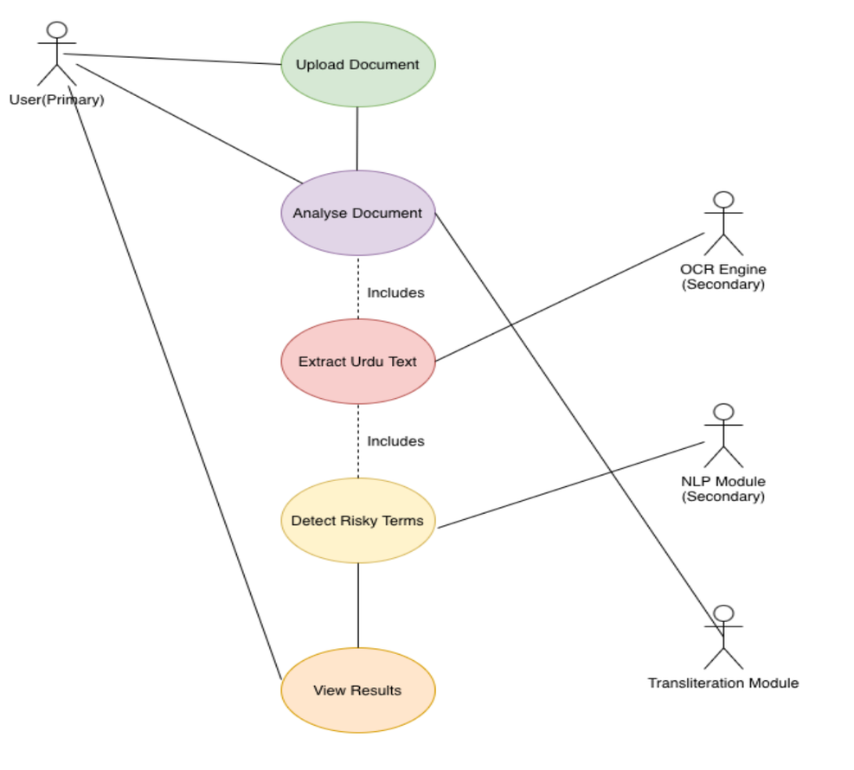
System Level Use Case
Main User Activities:
  Upload Urdu legal document
  Analyse document for risks
  View Roman Urdu transliteration
  Read risk report and explanations
Actor
End User (non-legally trained Pakistani citizen)
Secondary Actors
OCR Engine, NLP Module, Transliteration Module

Slide 12
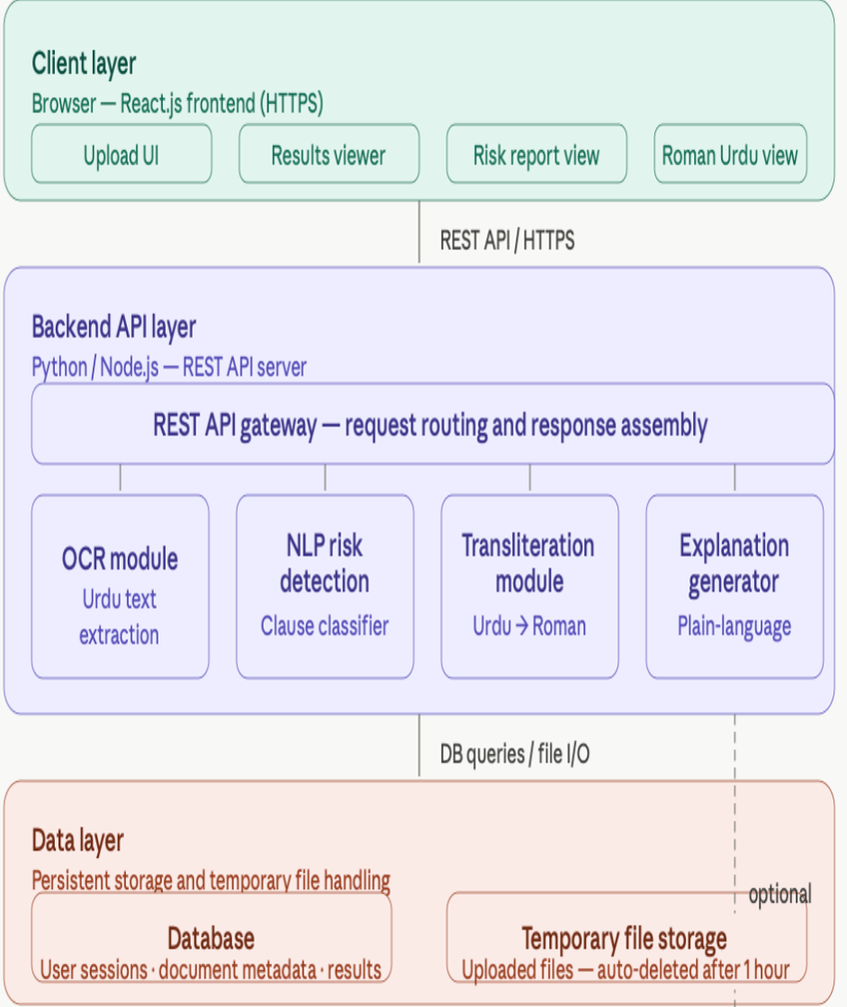
Architecture Diagram
Client Layer:
  React.js
  Firebase Hosting
Backend Layer:
  Google Cloud Functions
  Python
  Google Cloud Vision API (OCR)
  Hugging Face Transformers (NLP)
Data Layer:
  Firebase Firestore
  Firebase Storage
  Firebase Anonymous Auth
Data Flow:
User → React Frontend → Cloud Functions →
OCR + NLP Pipeline → Firebase → Results

Slide 13
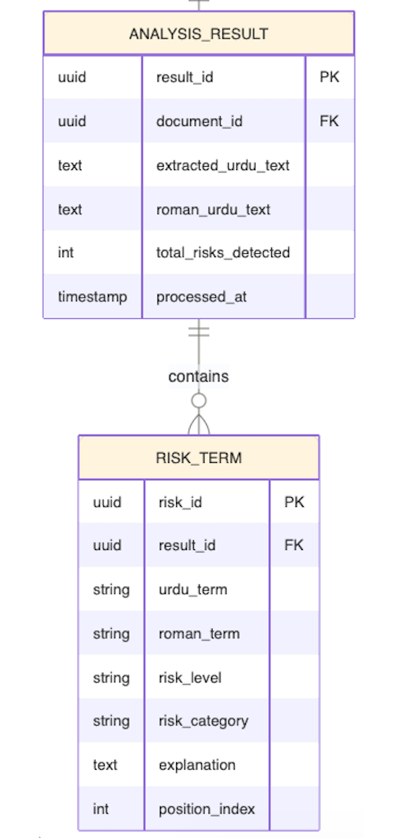
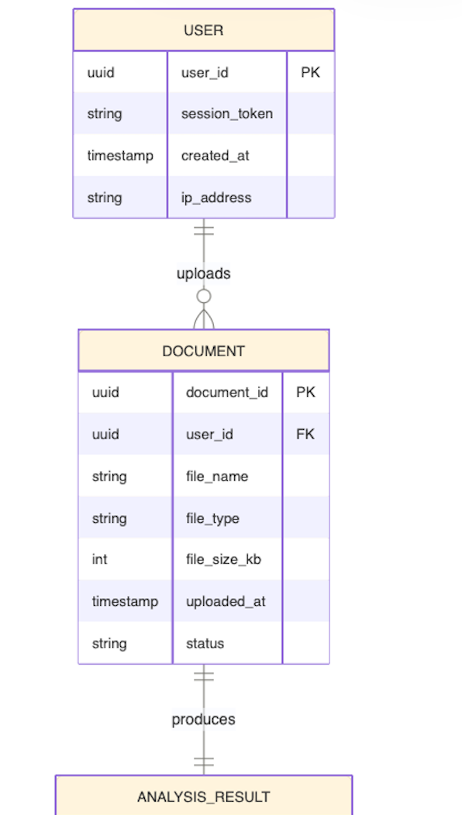
ERD Diagram

Slide 14
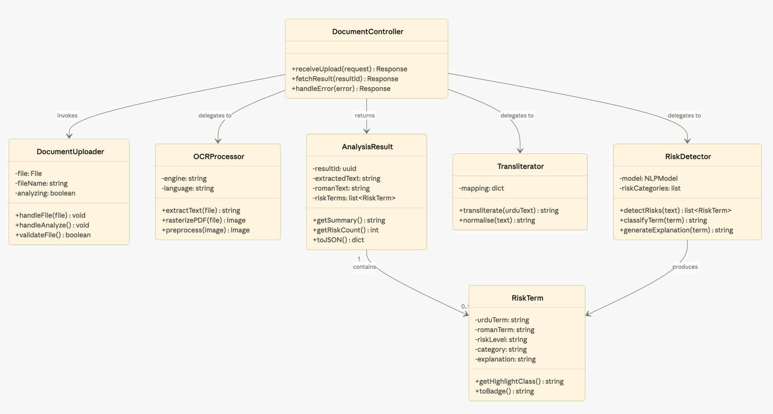
Class Diagram

Slide 15
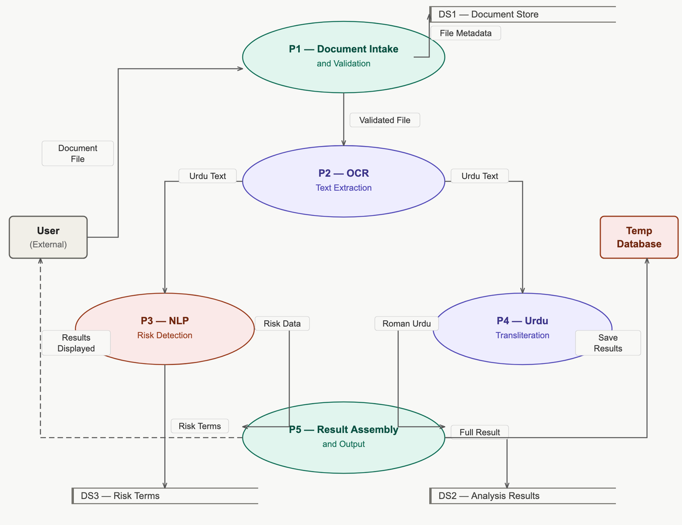
DFD-Level-1

Slide 16
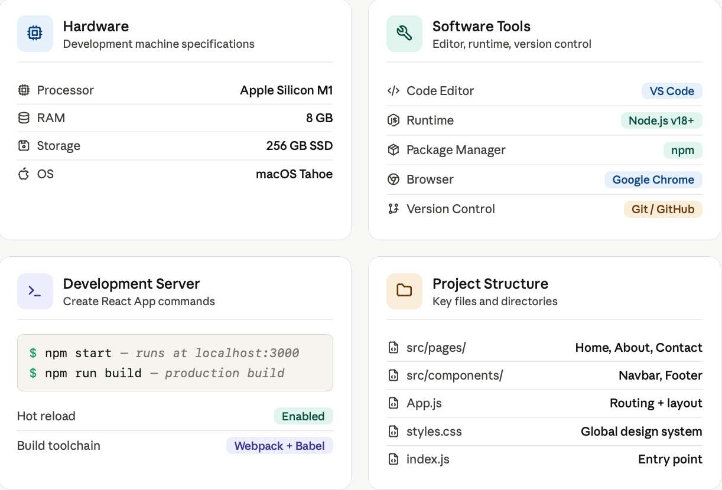
Development Environment

Slide 17

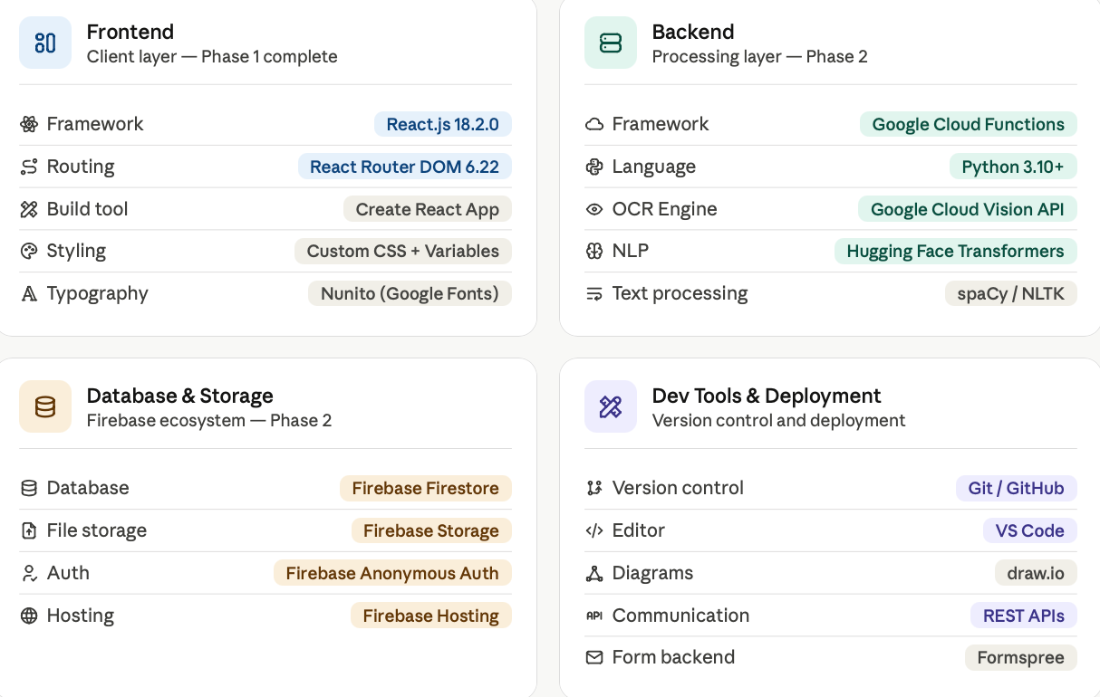
Technology Stack

Slide 18
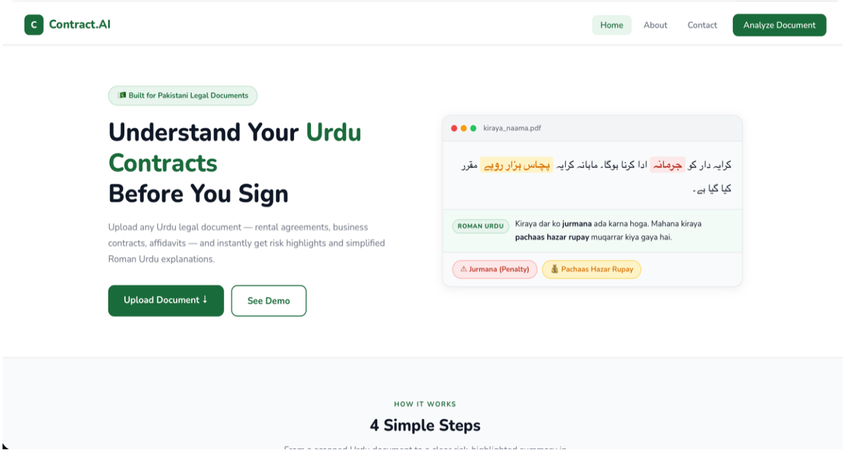
Landing page

Slide 19
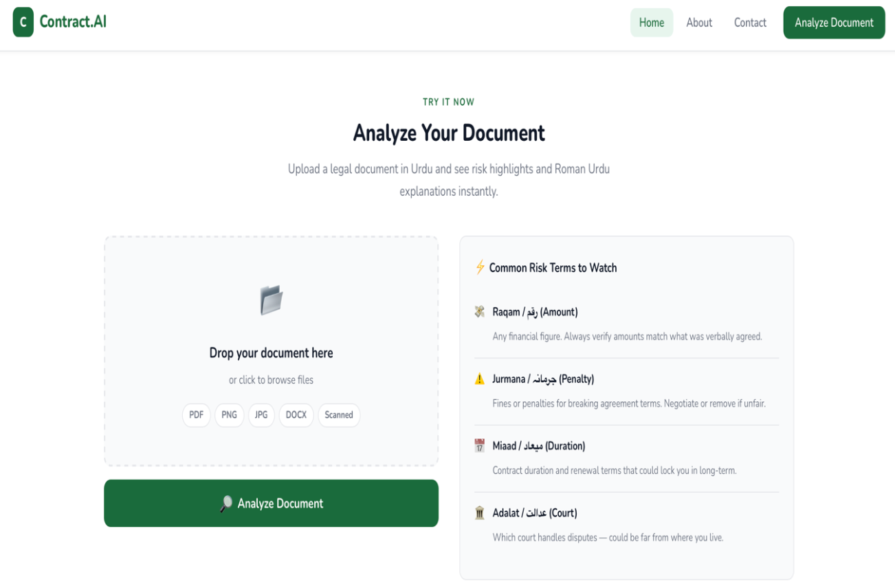
Working of Landing page

Slide 20
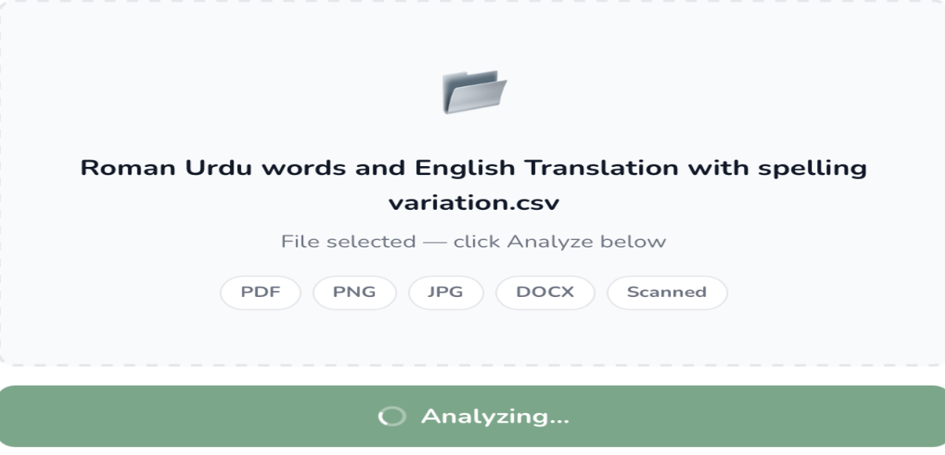

Slide 21
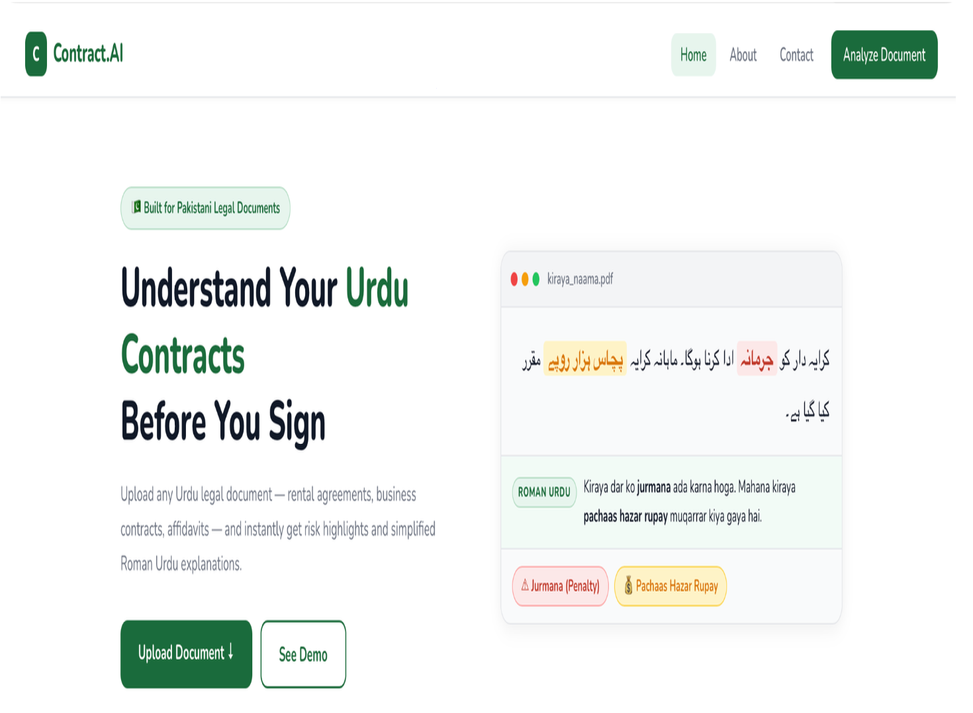
Upload

Slide 22
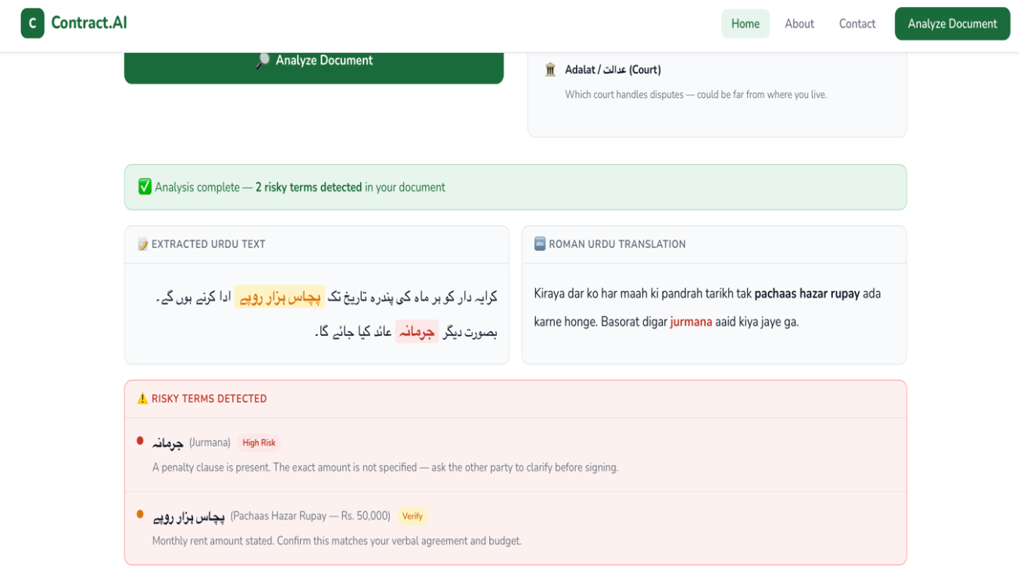
Result

Slide 23
References
[1] T. Rakoff, "Contracts of adhesion: An essay in reconstruction," Harvard Law Review, vol.
96, no. 6, pp. 1173–1284, Apr. 1983.
[2] O. Becher and L. Unger-Aviram, "The law of standard form contracts: Misguided
regulation," European Journal of Law and Economics, vol. 30, no. 2, pp. 115–134, Oct. 2010.
[3] LawGeex. (2018). "Comparing the performance of artificial intelligence to human lawyers
in the review of standard business contracts" [Online].
Available: https://www.lawgeex.com/AIvsLawyer
[4] Kira Systems. (2022). "Machine learning contract review" [Online].
Available: https://kirasystems.com
[5] S. Šarčević, New Approach to Legal Translation. The Hague: Kluwer Law International,
2012.
[6] S. Husain, "Challenges in Urdu text tokenization and segmentation," in Proc. Workshop on
Computational Approaches to Arabic Script-based Languages, Stanford, CA, 2009, pp. 40–
47.
[7] S. Naz, A. I. Umar, R. Ahmad, S. B. Ahmed, S. H. Shirazi, and M. I. Razzak, "Urdu Nastaliq
recognition using convolutional-recursive deep learning," Neurocomputing, vol. 243, pp. 80–
87, Jun. 2017.
[8] M. Lippi, P. Palka, G. Contissa, F. Lagioia, H. W. Micklitz, G. Sartor, and P. Torroni,
"CLAUDETTE: An automated detector of potentially unfair clauses in online terms of
service," Artificial Intelligence and Law, vol. 27, no. 2, pp. 117–139, Jun. 2019.
[9] I. Chalkidis, M. Fergadiotis, P. Malakasiotis, N. Aletras, and I. Androutsopoulos, "LEGAL-
BERT: The muppets straight out of law school," in Proc. Findings of the Association for
Computational Linguistics: EMNLP 2020, Online, Nov. 2020, pp. 2898–2904.

Slide 24
[10] A. Rafae, A. Nawab, M. Wyner, and A. Athar, "An unsupervised method for discovering
lexical variations in Roman Urdu informal text," in Proc. Workshop on Noisy User-generated
Text, Beijing, China, Jul. 2015, pp. 40–47.
[11] Meta AI. (2023). "React: A JavaScript library for building user interfaces" [Online].
Available: https://react.dev
[12] Remix Software. (2024). "React Router — Declarative routing for React" [Online].
Available: https://reactrouter.com
[13] Formspree. (2024). "Formspree — HTML form backend service" [Online].
Available: https://formspree.io
[14] OpenJS Foundation. (2024). "Node.js — JavaScript runtime environment" [Online].
Available: https://nodejs.org
[15] Facebook Open Source. (2023). "Create React App — Set up a modern web app by
running one command" [Online]. Available: https://create-react-app.dev
[16] Google Fonts. (2024). "Nunito — Google Fonts" [Online].
Available: https://fonts.google.com/specimen/Nunito
[17] W3C. (2023). "CSS custom properties for cascading variables" [Online].
Available: https://www.w3.org/TR/css-variables-1
[18] Tesseract OCR. (2024). "Tesseract open source OCR engine" [Online].
Available: https://github.com/tesseract-ocr/tesseract
[19] Hugging Face. (2024). "Transformers: State-of-the-art machine learning for PyTorch,
TensorFlow, and JAX" [Online]. Available: https://huggingface.co/docs/transformers
[20] A. Conneau, K. Khandelwal, N. Goyal, V. Chaudhary, G. Wenzek, F. Guzmán, E. Grave,
M. Ott, L. Zettlemoyer, and V. Stoyanov, "Unsupervised cross-lingual representation learning
at scale," in Proc. 58th Annual Meeting of the Association for Computational Linguistics
(ACL), Online, Jul. 2020, pp. 8440–8451.

Slide 25
[21] M. Z. Iqbal, A. Hussain, and M. A. Chaudhry, "A survey on Urdu language
processing," International Journal of Advanced Computer Science and Applications, vol. 9,
no. 4, pp. 148–157, Apr. 2018.
[22] I. Chalkidis, A. Fergadiotis, and I. Androutsopoulos, "Large-scale multi-label text
classification on EU legislation," in Proc. 57th Annual Meeting of the Association for
Computational Linguistics (ACL), Florence, Italy, Jul. 2019, pp. 6314–6322.
[23] K. Lo, L. L. Wang, M. Neumann, R. Kinney, and D. Weld, "S2ORC: The semantic scholar
open research corpus," in Proc. 58th Annual Meeting of the Association for Computational
Linguistics (ACL), Online, Jul. 2020, pp. 4969–4983.
[24] N. Habash and O. Rambow, "Arabic tokenization, part-of-speech tagging and
morphological disambiguation in one fell swoop," in Proc. 43rd Annual Meeting of the
Association for Computational Linguistics (ACL), Ann Arbor, MI, Jun. 2005, pp. 573–580.
[25] M. Afzal, M. Hussain, and T. Afzal, "Urdu text recognition: A survey," International
Journal of Computer Applications, vol. 975, no. 8887, pp. 34–41, Jan. 2016.

Slide 26
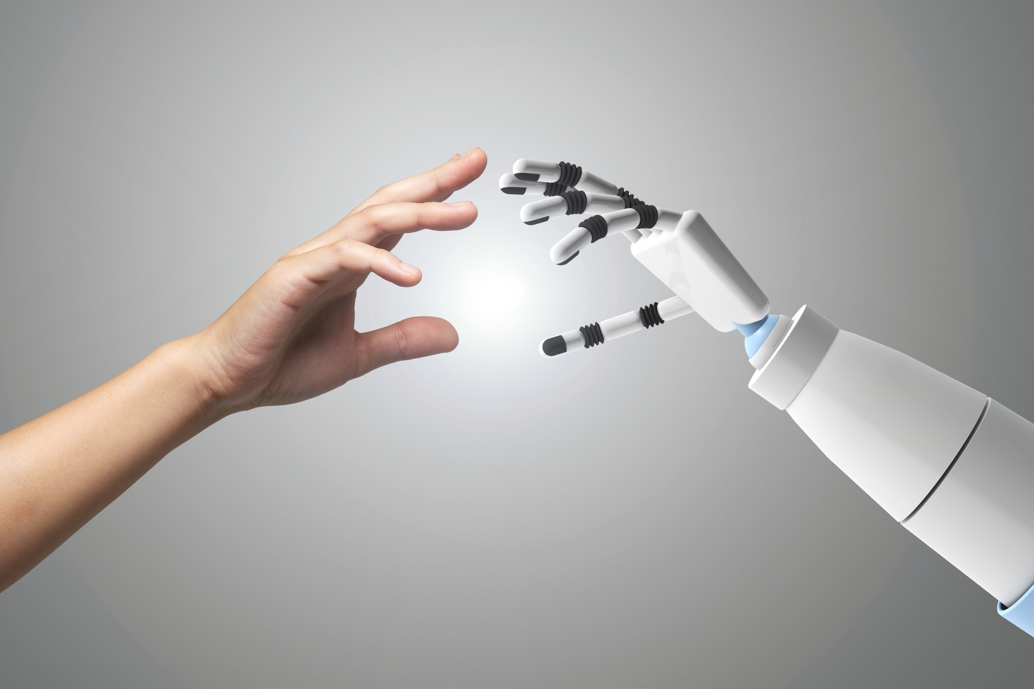
Thank You
Any Questions?

